Slide 1
MINI PROJECT

Slide 2
QUESTION
DISPLAY COMMAND LOCATION GIVEN THE COMMAND NAME AS INPUT (HINT: TAKE INPUT AND DISPLAY USING WHEREIS COMMAND)

Slide 3
REQUIREMENTS
1.Language used
python
2.LIBARIES USED:
PyQt5
Subprocess
3.IDE used
VSCode

Slide 4
PyQt5
PyQt developed by Riverbank Computing Limited.
PyQt5 contains over 620 classes that cover graphical user interfaces, XML handling, Web browsing and other technologies
Qt is set of cross-platform C++ libraries that implement high-level APIs for accessing many aspects of modern desktop and mobile systems.
Enables Python to be used as an alternative application development language to C++ on all supported platforms.

Slide 5
CODE
from PyQt5.QtCore import *
from PyQt5.QtWidgets import *
import os
import subprocess
class Page(QDialog):
def __init__(self, parent=None):
super(Page, self).__init__(parent)
self.my_label = QLineEdit("ls")
button = QPushButton("OUTPUT")
self.outputLabel = QLabel()
self.layout = QVBoxLayout()
self.layout.addWidget(self.my_label)
self.layout.addWidget(button)
self.setLayout(self.layout)

Slide 6
self.setLayout(self.layout)
self.setWindowTitle("COMMAND PATH")
button.clicked.connect(self.findCommand)
def findCommand(self):
stream = os.popen(self.my_label.text())
p = subprocess.Popen(["whereis",self.my_label.text()], stdout=subprocess.PIPE)
directory_content = p.stdout.readlines()[0]
length = len(directory_content)
outputText = str(directory_content[0:length-1])
self.outputLabel.setText(outputText )
self.layout.addWidget(self.outputLabel)
if __name__ == '__main__':
import sys
app = QApplication(sys.argv)
window = Page()
window.show()
sys.exit(app.exec_())

Slide 7
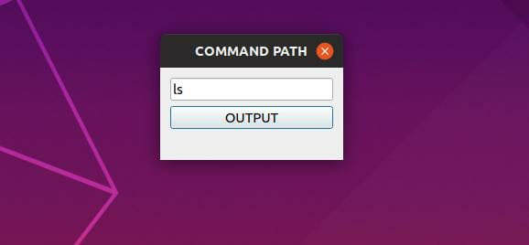
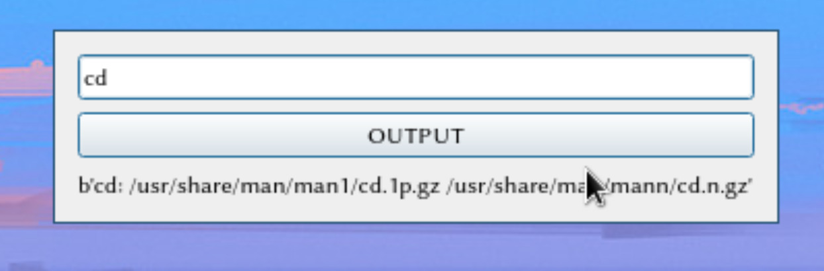
OUTPUT

Slide 8
TEAM MEMBERS
HARIKRISHNAN M
HARISHANKAR A
HONEY MARIAM BABU
IBNUL FARDEEN

Slide 9
THANK
YOU

